Slide 1
CS3210 Lab 4
MPI
Slides inspired by Sriram's slides
+ extra tidbits

Slide 2
Last Minute FAQ for Lab 2
Why isn't my write operation in my kernel propagated back to my host despite writing to __managed__ memory?
Calling your kernels effectively puts them in the background while your host continues with its other operations!
Need to call cudaDeviceSynchronize() on your host before reading the updated managed memory!

Slide 3
The Burj Khalifa view of CS3210
Part 1: OpenMP
Making single-node CPU programs faster
Complex tasks that are relatively less parallelizable (10s of tasks)
Part 2: CUDA
Making single-node GPU-able programs faster
Simpler tasks that are relatively more parallelizable (millions of tasks even)
Part 3: MPI
Making multi-node programs faster
Large, mixed workloads (slow communication between nodes is worth it due to size / parallelizabilty of work)
You are here!

Slide 4
Some naming confusion
OpenMP != MPI != OpenMPI
 | OpenMP | MPI | OpenMPI
Shared or distributed memory? | Shared | Distributed | Distributed
Just the standard, or actual implementation? | Implementation | Just a standard | Implementation of the MPI standard

Slide 5
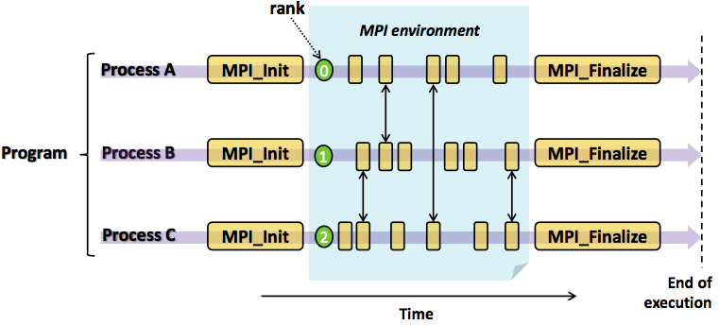
MPI Program Lifecycle

Slide 6
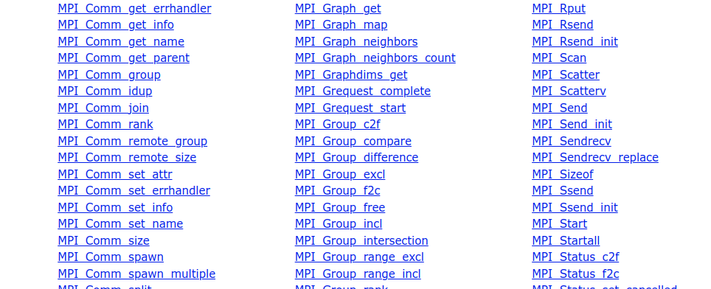
MPI is all about communicating
If independent processes: we could just do srun/sbatch over many nodes
Difficulty is in communicating: therefore “Message Passing Interface”

Slide 7
Slurm + MPI

Slide 8
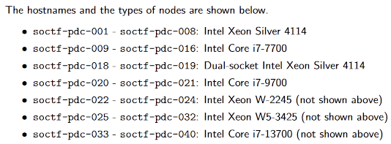
Slurm + MPI
- 10C/20T
- 4C/8T
- 20C/40T
- 8C/8T
- 8C/16T
hx hello.cc
mpic++ -o hello hello.cc
salloc -n 104 -N 3 mpirun ./hello
salloc -n 105 -N 3 mpirun ./hello
salloc -n 105 -N 3 --oversubscribe mpirun ./hello
sacct
- 12C/24T
- 16C/24T

Slide 9
Multi-Node Slurm Scheduling/Accounting
Priority-based scheduling
Based on job age + your priority + how "large" your job is
There are limits for:
MaxNodesPerJob: 5
MaxJobs: 1 [max running jobs]
Max time per job: 3 min
Etc.
The limits above are subject to changes.
Lots of people sharing few nodes, so use only what you need!

Slide 10
Important paradigm things in MPI
int rank, size;
char hostname[256];
MPI_Init(&argc, &argv);
MPI_Comm_rank(MPI_COMM_WORLD, &rank);
MPI_Comm_size(MPI_COMM_WORLD, &size);
Why don’t I need to synchronize rank and size?
.

Slide 11
Important paradigm things in MPI
int rank, size;
char hostname[256];
MPI_Init(&argc, &argv);
MPI_Comm_rank(MPI_COMM_WORLD, &rank);
MPI_Comm_size(MPI_COMM_WORLD, &size);
Why don’t I need to synchronize rank and size?
This is a distributed memory programming model! The processes are running in independent memory spaces!

Slide 12
Important paradigm things in MPI
Do MPI programs spawn the processes upon calling MPI_Init()?
hx mpi_sleep.cpp
mpic++ -o mpi_sleep mpi_sleep.cpp
salloc --nodes 1 --ntasks-per-node 24 mpirun ./mpi_sleep
(run ps -A on soctf-pdc-018 during the demo too)

Slide 13
Important paradigm things in MPI
Do MPI programs spawn the processes upon calling MPI_Init()?
No! The necessary processes are spawned by executing mpirun.
MPI_Init() only sets up the communication channels between the different processes.
Take note: anything done before MPI_Init() & after MPI_Finalize() is considered undefined behaviour in a MPI program.
Ref: https://www.mpich.org/static/docs/v3.3/www3/MPI_Finalize.html

Slide 14
Today's Lab

Slide 15
For MPI…
…we're back to using soctf again! Please do not do your lab on xlogin!
Add the following line to your .bash_profile
export OMPI_MCA_btl_tcp_if_include=172.26.187.34/23
Required by some exercises, sent in Telegram (might not be in your lab sheet.)

Slide 16
Lab 4: MPI
ex1/2: Running MPI programs locally, “manual” MPI distribution
ex3: Running across many nodes with Slurm
ex4: Mapping and binding MPI processes
ex5/6/7: Blocking MPI communication
ex8: Non-blocking MPI communication
ex9/10/11 (for submission!): MPI performance comparison
Submission by 28th October 2pm
yes, you have less than a week, but this is the final (mandatory) lab submission!

Slide 17
ex2: ssh-copy-id failure
If this fails, you don't have an ssh key on the node
Run first: ssh-keygen -t ed25519 on your login soctf node
Then, follow the instructions (or just hit Enter 3 times if you're lazy to read)

Slide 18
mpirun: Mapping and Binding
Crucial for performance!

Slide 19
How to understand map/bind behaviour?
Slot: the smallest unit an MPI process can get allocated to
#slots determined by
Slurm (or whatever "batch system" is used), or
Slurm's default is #logical cores
#physical processor cores on the node OR
if --use-hwthread-cpus specified, use #logical cores
Default: MPI allows 1 process per slot unless you specify --oversubscribe
mpirun ./hello
mpirun --use-hwthread-cpus ./hello
salloc -p xs-4114 mpirun ./hello

Slide 20
How to understand map/bind behaviour?
Processing element (PE) - can be used later for map/bind
By default, a physical core
If --use-hwthreads-cpus, then it’s a logical core
Mapping: deciding which processes run on which node
{slot, hwthread, core, L1cache, L2cache, L3cache, socket, numa, board, node}
PE in purple are not covered, only FYI
Binding: constraining a process to specific CPUs
If there is an “object-specific” mapping, binding usually automatically set to match it
salloc -p xs-4114 --nodes 1 --ntasks 4 mpirun --report-bindings --map-by slot:pe=1 ./hello
salloc -p xs-4114 --nodes 1 --ntasks 4 mpirun --report-bindings --map-by slot:pe=2 ./hello

Slide 21
More on mapping and binding
Let’s try to figure out more worked examples
salloc -p dxs-4114 --nodes 1 --ntasks 20 mpirun --report-bindings --map-by socket --bind-to core ./hello
Mapped to each socket in round-robin fashion, each proc bound to a core
salloc -p dxs-4114 --nodes 1 --ntasks 10 mpirun --report-bindings --map-by socket:pe=2 --bind-to core ./hello
Mapped to each socket in round-robin fashion, each proc bound to 2 cores

Slide 22
More on mapping and binding
salloc -p i7-7700 --nodes 2 --ntasks 6 bash -c 'mpirun --map-by core --bind-to hwthread --report-bindings ./hello 2>&1 | sort'
salloc -p i7-7700 --nodes 2 --ntasks 6 bash -c 'mpirun --map-by hwthread --bind-to hwthread --report-bindings ./hello 2>&1 | sort'
Mapping applies round-robin, across cores or hwthreads in this case, then we bind specifically to a hwthread each time
Additional reading if my explanation is not clear enough: https://nekodaemon.com/2021/02/05/Understanding-MPI-map-by-and-bind-to-option/

Slide 23
Differences between MPI Sends/Recvs

Slide 24
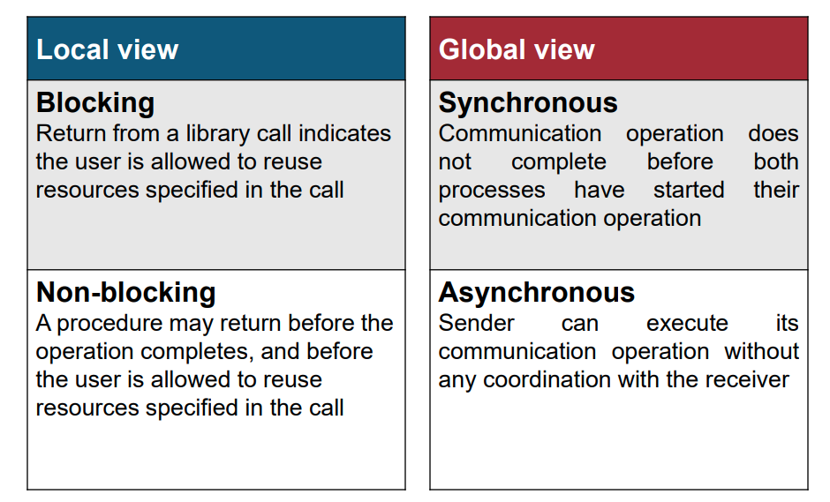
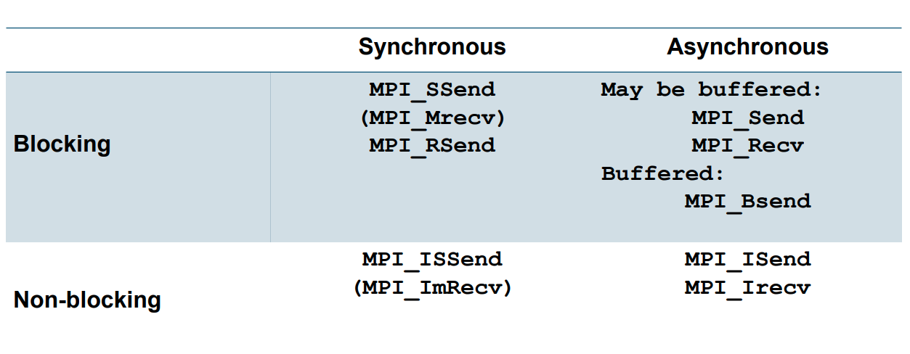
Overview
Non-Local view
24

Slide 25
Difference between MPI_Send & MPI_SSend?
If both of them are blocking anyways, what's the difference?

Slide 26
Difference between MPI_Send & MPI_SSend?
If both of them are blocking anyways, what's the difference?
There's a difference between when they will return control flow to the application!
MPI_Send will return to the application when the input buffer is ready for reuse.
MPI_SSend will return when input buffer (i.e. the buffer defined in application that holds the data to be sent) is ready for reuse AND receiver started receiving the data.

Slide 27
MPI_Send's behaviour
The only guarantee is that it will always returns when programmer-defined application-side input buffer is ready to be reused.
Can exhibit different behaviours depending on the size of the message, the availability of system buffers, the specific implementation of MPI, and the network hardware.
[Similar to Bsend] Input data can be buffered into MPI's system buffer if it can fit. MPI_Send will then return afterwards, & does not necessarily require a matching receive.
[Similar to Ssend] Input data is too large to fit into MPI's system buffer - A matching receive is required in this case to send the data over so that the programmer-defined buffer can be reused (and thus allowing MPI_Send to return).

Slide 28
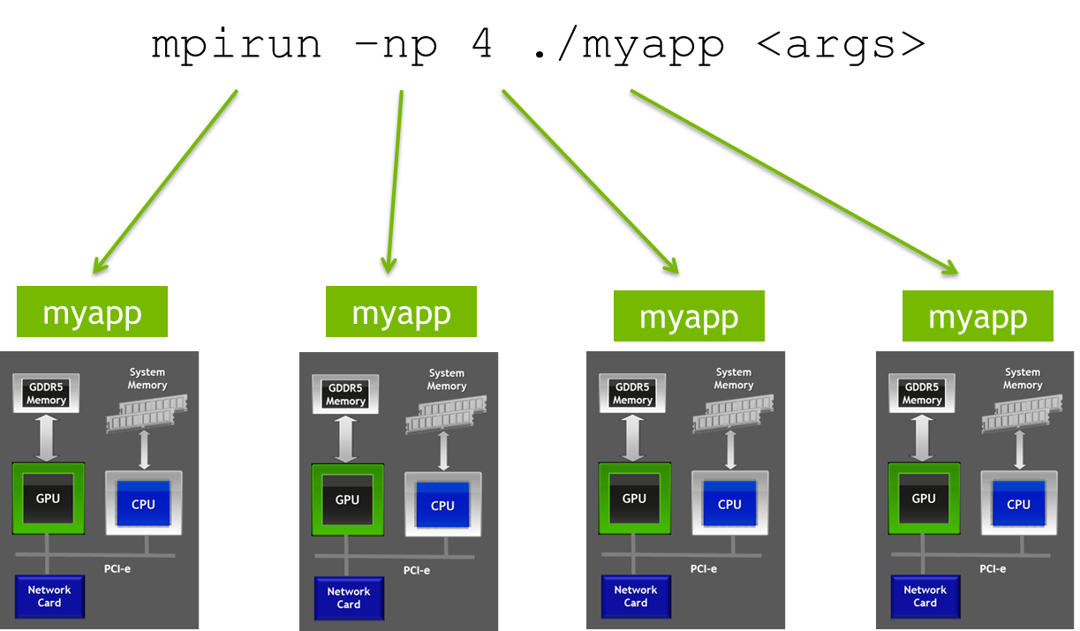
Bonus: These are not mutually exclusive!
MPI distributes processes to nodes (note: can have more than 1 process per node!)
OpenMP
CUDA
Diagram is only just FYI. For CS3210, we do not expect you to combine CUDA+OpenMP+MPI!

Slide 29
End of Lab 4
Slides uploaded (or will be) at the usual place
Feedback open as always

